Slide 1

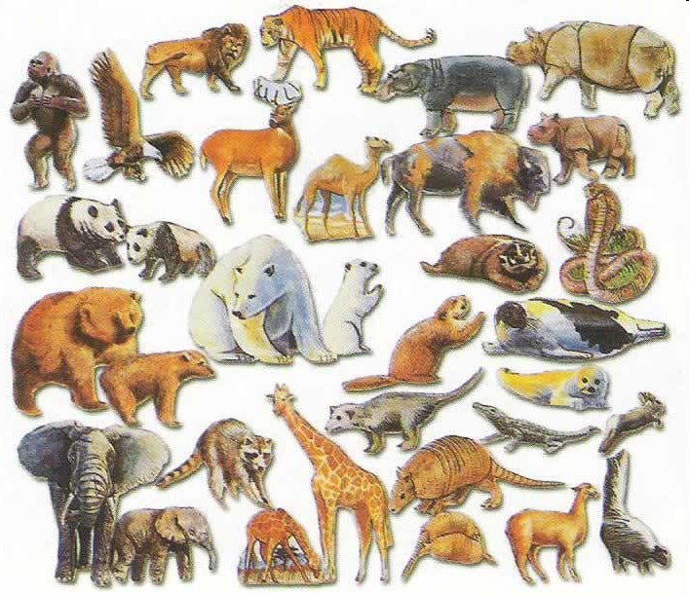
Interface Inheritance
Introduction to Computer Science
Reichman University
Lecture 11-1

Slide 2
Inheritance
Background
Inheritance is a major feature of object-oriented programming
We’ll give an introduction to inheritance, focusing on main concepts and techniques.
Two forms of inheritance
Class inheritance (last lecture)
Interface inheritance (this lecture)

Slide 3
Lecture plan
Using interfaces for:
Type hierarchies
Polymorphism / heterogeneous collections
Standardizing software
Multiple inheritance

Slide 4
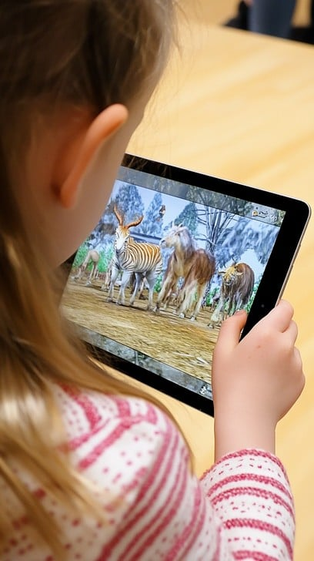
Type hierarchy
Required (example)
A simple computer game;
The player sees a random set of animals
The player can:
Select an animal
Play the animal’s sound
Feed the animal
Do other animal-specific things

Slide 5
Type hierarchy
Type Hierarchy
Required (example)
A simple computer game;
The player sees a random set of animals
The player can:
Select an animal
Play the animal’s sound
Feed the animal
Do other animal-specific things
Animal
interface
is-a
Dog
Cow
Mouse
regular classes
is-a
shifra
pua
(objects)
Software architecture
Declare an Animal type, representing the common properties and operations (behavior) that each Animal object must have
Declare Animal sub-types: Cow, Dog, Mouse, ..., each representing the common behavior plus animal-specific behaviors
Model this type hierarchy using interface inheritance.
(looks same as class-inheritance, but it’s not. Stay tuned)

Slide 6
Type hierarchy: Design
Type Hierarchy
/** An Animal (for a simple computer game) */
public interface Animal {
/** The sound that this animal makes */
public String sound();
/** The food that this animal eats */
public Object eats();
}
Animal
interface
is-a
Dog
Cow
Mouse
regular classes
is-a
shifra
pua
(objects)
Software architecture
Declare an Animal type, representing the common properties and operations (behavior) that each Animal object must have
Declare Animal sub-types: Cow, Dog, Mouse, ..., each representing the common behavior plus animal-specific behaviors
Model this type hierarchy using interface inheritance.

Slide 7
Type hierarchy: Design
Type Hierarchy
/** An Animal (for a simple computer game) */
public interface Animal {
/** The sound that this animal makes */
public String sound();
/** The food that this animal eats */
public Object eats();
}
Animal
interface
is-a
Dog
Cow
Mouse
regular classes
is-a
/** A Cow */
public class Cow implements Animal {
String food = "hay";
int weight;
/** Constructs a cow. */
public Cow(int weight) {
this.weight = weight;
}
/** The sound of this cow. */
public String sound() { return "moo"; }
/** The food of this cow. */
public String eats() { return food; }
/** The weight of this cow */
public double weight() { return weight; }
}
shifra
pua
(objects)
Software architecture
Declare an Animal type, representing the common properties and operations (behavior) that each Animal object must have
Declare Animal sub-types: Cow, Dog, Mouse, ..., each representing the common behavior plus animal-specific behaviors
Model this type hierarchy using interface inheritance.

Slide 8
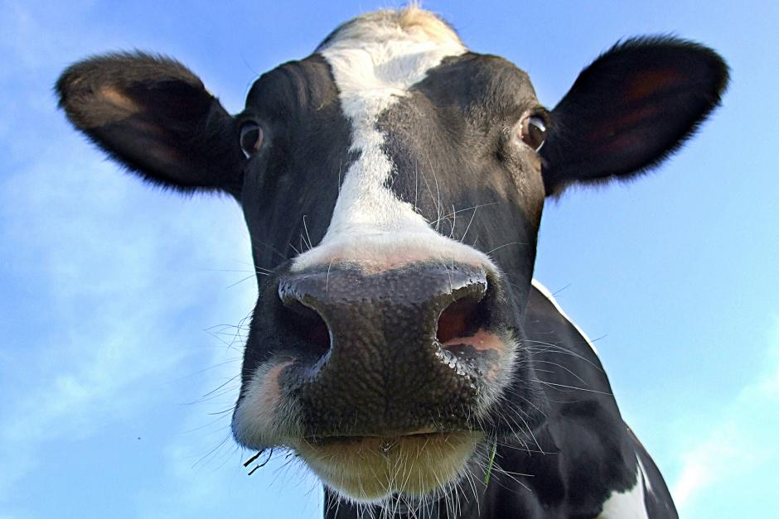
Type hierarchy: Design
Type Hierarchy
/** An Animal (for a simple computer game) */
public interface Animal {
/** The sound that this animal makes */
public String sound();
/** The food that this animal eats */
public Object eats();
}
Animal
interface
is-a
Dog
Cow
Mouse
regular classes
is-a
/** A Cow */
public class Cow implements Animal {
String food = "hay";
int weight;
/** Constructs a cow. */
public Cow(int weight) {
this.weight = weight;
}
/** The sound of this cow. */
public String sound() { return "moo"; }
/** The food of this cow. */
public String eats() { return food; }
/** The weight of this cow */
public double weight() { return weight; }
}
shifra
pua
(objects)
// Client code, in any class:
Cow shifra = new Cow();
System.out.println(shifra.sound());
moo
Notes:
‹#›

Slide 9
Type hierarchy: Design
/** An Animal (for a simple computer game) */
public interface Animal {
/** The sound that this animal makes */
public String sound();
/** The food that this animal eats */
public Object eats();
}
An interface:
Consists only of abstract methods
Has a regular API
Compiled just like a class
BUT: An interface is not a class: no fields, no constructors, no new Animal
/** A cow */
public class Cow implements Animal {
String food = "hay";
int weight;
/** Constructs a cow. */
public Cow(int weight) {
this.weight = weight;
}
/** The sound of this cow. */
public String sound() { return "moo"; }
/** The food of this cow. */
public String eats() { return food; }
/** The weight of this cow */
public double weight() { return weight; }
}
Classes that implement an interface:
Are regular classes
Must implement every interface method
(or get a compilation error)
Typically define additional methods.
Notes:
‹#›

Slide 10
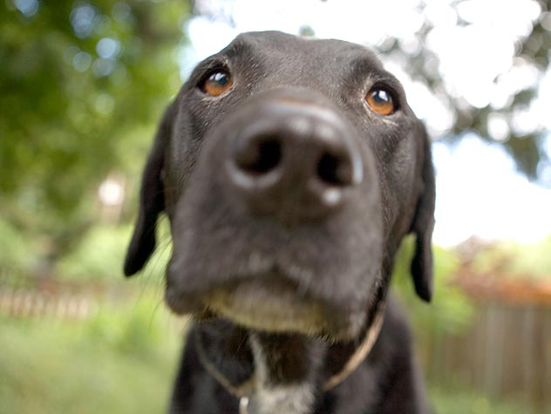
Type hierarchy: Design
/** An Animal (for a simple computer game) */
public interface Animal {
/** The sound that this animal makes */
public String sound();
/** The food that this animal eats */
public Object eats();
}
/** A dog. */
public class Dog implements Animal {
String food = "bonzo";
/** Constructs a dog. */
public Dog() {
}
/** The sound of this dog. */
public String sound() { return "woof"; }
/** The food of this dog. */
public String eats() { return food; }
/** Causes this dog to fetch the given object */
public void fetch(Object obj) {
//code omitted, depends on the game dynamics
}
}
// Client code, in any class:
Dog scooby = new Dog();
System.out.println(scooby.sound());
woof

Slide 11
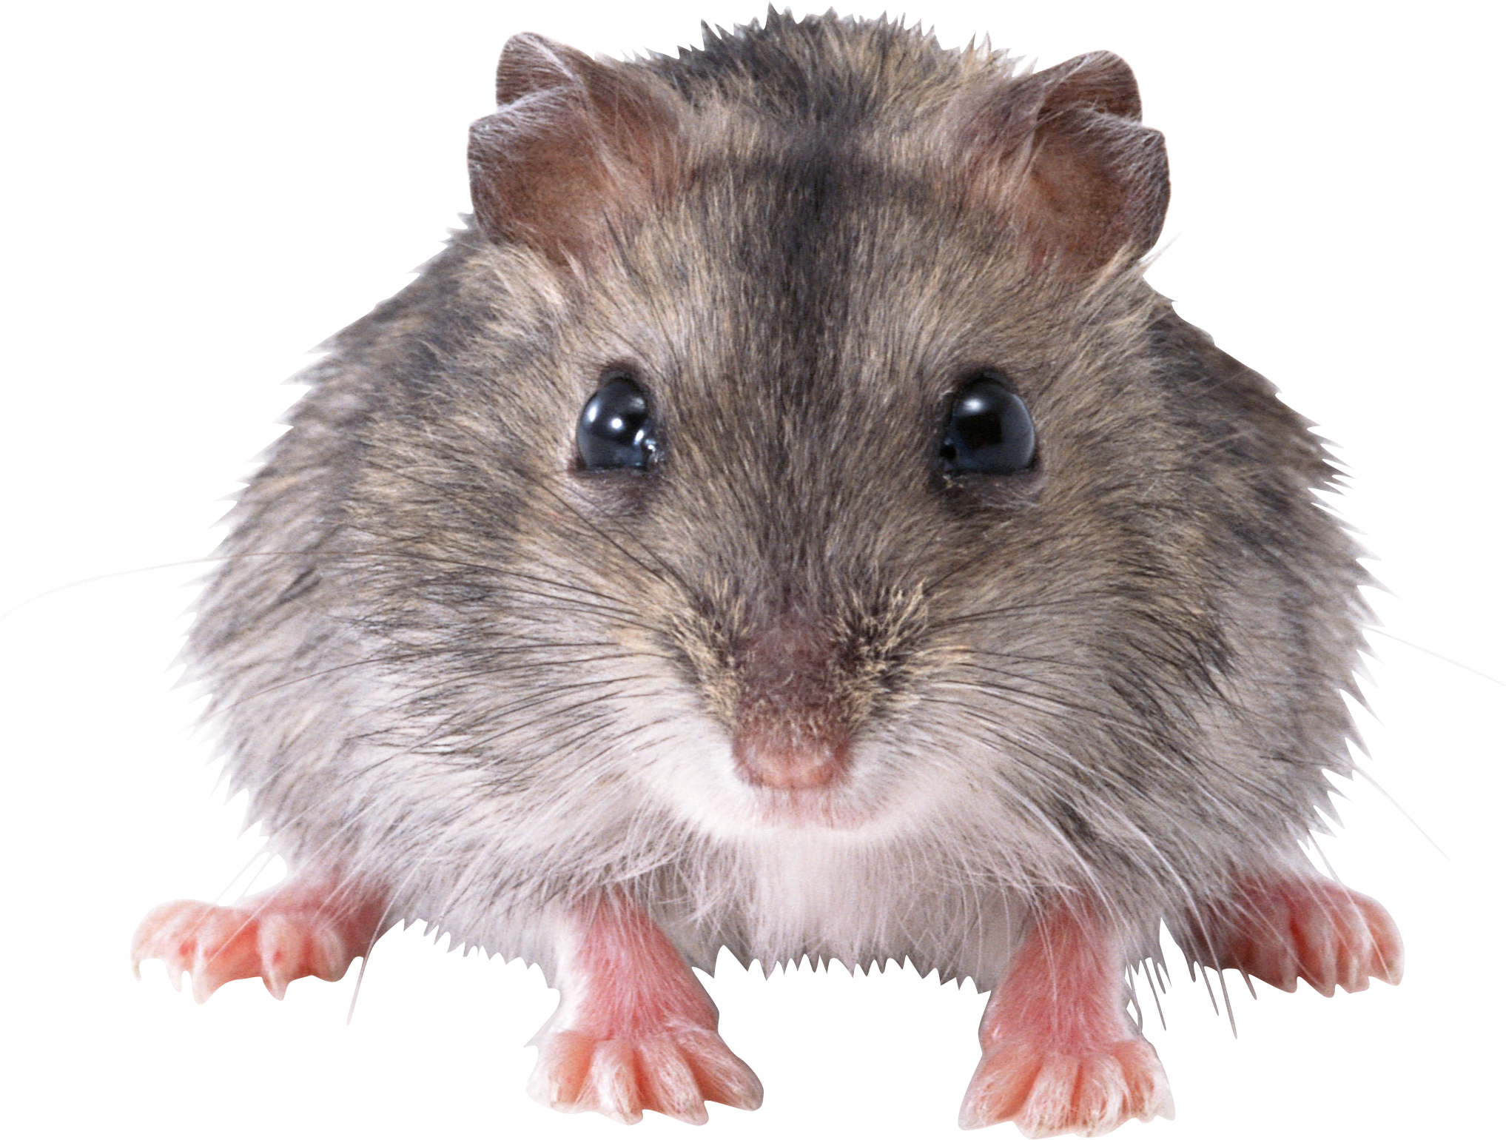
Type hierarchy: Design
/** An Animal (for a simple computer game) */
public interface Animal {
/** The sound that this animal makes */
public String sound();
/** The food that this animal eats */
public Object eats();
}
/** A mouse. */
public class Mouse implements Animal {
String food = "crumbs";
/** Constructs a mouse. */
public Mouse() {}
/** The sound of this mouse. */
public String sound() { return "squeak"; }
/** The food of this mouse. */
public String eats() { return food; }
/** Sets the food of this mouse */
public void setFood(String food) {
this.food = food; }
}
// Client code, in any class:
Mouse mik = new Mouse();
System.out.println(mik.sound());
squeak

Slide 12
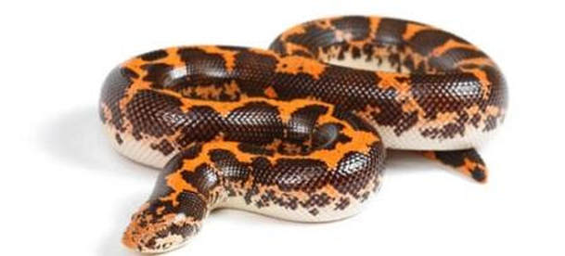
Type hierarchy: Design
/** An Animal (for a simple computer game) */
public interface Animal {
/** The sound that this animal makes */
public String sound();
/** The food that this animal eats */
public Object eats();
}
/** A boa. */
public class Boa implements Animal {
// The food of this boa
Animal food;
/** Constructs a boa and feeds it right away */
public Boa(Animal a) {
food = a;
}
/** The sound that this boa makes. */
public String sound() {
return "((" + food.sound() + "))";
}
/** The food of this boa. */
public Animal eats() { return food; }
}
// Client code, in any class:
Boa kaa = new Boa(new Mouse());
System.out.println(kaa.sound());
((squeak))

Slide 13
Type hierarchy: Design
/** An Animal (for a simple computer game) */
public interface Animal {
/** The sound that this animal makes */
public String sound();
/** The food that this animal eats */
public Object eats();
}
/** A boa. */
public class Boa implements Animal {
// The food of this boa
Animal food;
/** Constructs a boa and feeds it right away */
public Boa(Animal a) {
food = a;
}
/** The sound that this boa makes. */
public String sound() {
return "((" + food.sound() + "))";
}
/** The food of this boa. */
public Animal eats() { return food; }
}
// Client code, in any class:
Boa kaa = new Boa(new Mouse());
System.out.println(kaa.sound());
Boa luna = new Boa(kaa);
System.out.println(luna.sound());
((squeak))
((((squeak))))

Slide 14
Type hierarchy: Design
/** An Animal (for a simple computer game) */
public interface Animal {
/** The sound that this animal makes */
public String sound();
/** The food that this animal eats */
public Object eats();
}
/** A boa. */
public class Boa implements Animal {
// The food of this boa
Animal food;
/** Constructs a boa and feeds it right away */
public Boa(Animal a) {
food = a;
}
/** The sound that this boa makes. */
public String sound() {
return "((" + food.sound() + "))";
}
/** The food of this boa. */
public Animal eats() { return food; }
}
Notice the data types
// Client code, in any class:
Boa kaa = new Boa(new Mouse());
System.out.println(kaa.sound());
Boa luna = new Boa(kaa);
System.out.println(luna.sound());
((squeak))
((((squeak))))

Slide 15
Lecture plan
Using interfaces for:
Type hierarchies
Polymorphism / heterogeneous collections
Standardizing software
Multiple inheritance

Slide 16
Type hierarchy: Use
// Client code, in some class:
// Creates some animals and plays their sounds.
Cow pua = new Cow(500);
Dog puff = new Dog();
System.out.println(pua.sound()); // moo
System.out.println(puff.sound()); // woof
Animal
interface
is-a
Dog
Cow
classes
is-a
puff
pua
objects

Slide 17
Type hierarchy: Use example 1
// Client code, in some class:
// Creates some animals and plays their sounds.
Cow pua = new Cow(500);
Dog puff = new Dog();
System.out.println(pua.sound()); // moo
System.out.println(puff.sound()); // woof
sounds(pua, 2);
sounds(puff, 3);
// Casuse the given animal to make its sound, n times
private static void sounds(Animal a, int n) {
for (int i = 0, i++, i < b) {
System.out.println(a.sound());
}
}
Animal
interface
is-a
Dog
Cow
classes
is-a
puff
pua
objects
moo
moo
woof
woof
woof
Polymorphic processing
sounds is a polymorphic method: The type of one of its arguments is an interface;
Different objects that implement this interface may do different things.
Making the argument of this method Animal is an example of upcasting.

Slide 18
Type hierarchy: Use example 2
// Creates a heterogeneous array of Animal objects:
Animal[] animals = { new Cow(500), new Dog(), new Mouse() };
for (Animal a : animals) {
System.out.println(a.getClass().getName()+ " goes " + a.sound());
}
Cow goes moo
Dog goes woof
Mouse goes squeak
getClass(): an Object method, returns a Class object that represents the class to which this object belongs
getName(): a Class method,
returns the name of this class, as a string

Slide 19

Type hierarchy: Use example 3
Old MacDonald had a farm, E-I-E-I-O
And on this farm he had a Cow, E-I-E-I-O
With a moo here and a moo there
Here a moo there a moo
Everywhere a moo moo
Old MacDonald had a farm, E-I-E-I-O
Old MacDonald had a farm, E-I-E-I-O
And on this farm he had a Dog, E-I-E-I-O
With a woof here and a woof there
Here a woof there a woof
Everywhere a woof woof
Old MacDonald had a farm, E-I-E-I-O
Old MacDonald had a farm, E-I-E-I-O
And on this farm he had a Mouse, E-I-E-I-O
With a squeak here and a squeak there
Here a squeak there a squeak
Everywhere a squeak squeak
Old MacDonald had a farm, E-I-E-I-O
Task:
Produce an Old MacDonald song for a farm of animals
Let the user decide which animals will be in the farm / song.

Slide 20
Type hierarchy: Use example 3
public static void main(String[] args) {
// Put here any animal you want
Animal[] farm = { new Cow(500), new Dog(), new Mouse() };
// Produces the song, one verse for each animal in the farm
for (Animal animal : farm)
oldMacDonaldVerse(animal);
}
private static void oldMacDonaldVerse(Animal animal) {
String eieio = ", E-I-E-I-O";
System.out.println("Old MacDonald had a farm" + eieio);
System.out.println("And in this farm he had a " + animal.getClass().getName() + eieio);
String sound = animal.sound();
System.out.println("With a " + sound + " here and a " + sound + " there" );
System.out.println( "Here a " + sound + " there a " + sound);
System.out.println("Everywhere a " + sound + " " + sound);
System.out.println("Old MacDonald had a farm" + eieio);
}
farm: a heterogeneous collection
Old MacDonald had a farm, E-I-E-I-O
And on this farm he had a Cow, E-I-E-I-O
With a moo here and a moo there
Here a moo there a moo
Everywhere a moo moo
Old MacDonald had a farm, E-I-E-I-O
One example out of the three verses (בתים)

Slide 21
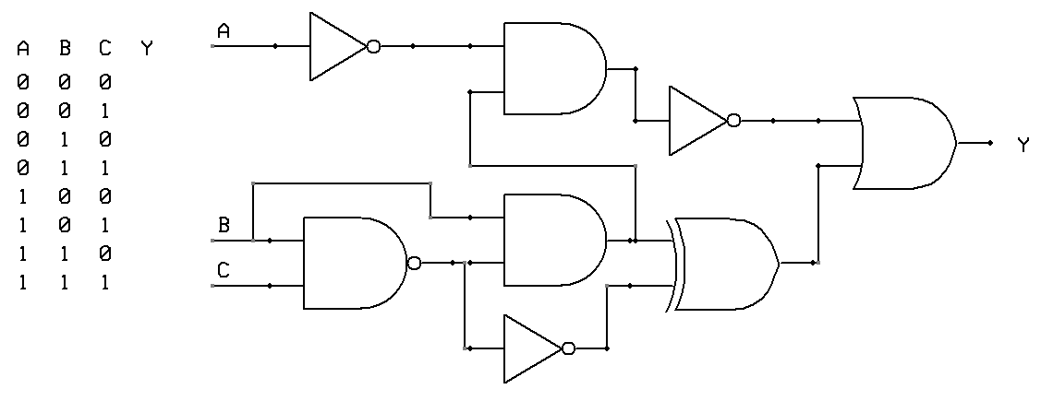
Type hierarchy: Use example 4 (yes, interfaces also have very serious uses...)
/** Logic gate interface */
public interface Gate {
/** Returns the value of this gate */
public boolean eval(List<Gate> inputs);
/** Draws this gate */
public void draw();
// More abstract Gate methods
}
/** And gate */
public AndGate implements Gate {
// Fields and constructors ...
public boolean eval(...) {...}
public void draw() {...}
// More AndGate methods
}
/** Or gate */
public OrGate implements Gate {
// Fields and constructors ...
public boolean eval(...) {...}
public void draw() {...}
// More OrGate methods
}
/** Not gate */
public NotGate implements Gate {
// Fields and constructors ...
public boolean eval(...) {...}
public void draw() {...}
// More NotGate methods
}
Hardware simulator
Used to construct, evaluate, and draw logic circuites (chips):
. . .
Not
And
Not
Or
And
And
Xor
Not

Slide 22
Virtual method calling
Animal animal;
Cow pua = new Cow(500);
Dog puff = new Dog();
// The following code serves no purpose, except for illustrating
// a feature of Java known as “virtual method calling”
animal = pua; // animal points to a Cow object (downcasting)
System.out.println(animal.sound());
animal = puff; // Now animal points to a Dog object
System.out.println(animal.sound());
Animal
interface
is-a
Dog
Cow
classes
moo
woof
Observations
During compile-time, we have two identical method calls: animal.sound()
During run-time, we’ll end up calling two different methods: Cow.sound() and then Dog.sound()
Virtual method calling / AKA Late Binding:
We see that object types can change (upcasted or downcasted) along the type hierarchy;
Which method to invoke on an object is determined during run-time, according to the object’s run-time type.

Slide 23
Lecture plan
Using interfaces for:
Type hierarchies
Polymorphism / heterogeneous collections
Standardizing software
Multiple inheritance

Slide 24
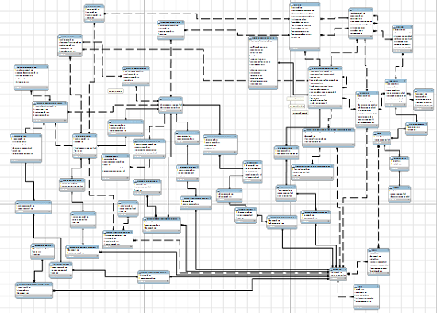
Using interfaces to standardize systems
The challenge
Software systems may be based on many classes, built by (possibly) many developers
The classes are made to interact with each other
How to reduce complexity?
Interfaces!
Good systems are characterized by common design rules, constraints, and terminology;
These standards can be managed using interfaces.

Slide 25
Using interfaces to standardize systems: Example 1
Example: Object comparison
How to compare strings? dates? fractions? sets? polynomials? …
The comparisons are domain-specific
However, Java helps standardize object comparisons, using an interface named Comparable

Slide 26
Using interfaces to standardize systems: Example 1
From Java’s class library:
From Java’s class library:
/** Imposes a total ordering on the objects of each class that implements it. Objects are compared using the compareTo method. Lists and arrays of objects that implement this interface can be sorted automatically by Java’s Arrays.sort method. */
public interface Comparable<T> {
/** Compares this object with the other object.
Returns a negative integer, zero, or a positive integer as this
object is less than, equal to, or greater than the other object. */
public int compareTo(T other);
}
/** A library of array processing functions */
public class Arrays
...
/** Sorts the given array into ascending order, according to the natural ordering of its elements. The array elements must implement the Comparable interface. */
static public void sort(Object[] arr)
...
My code
Client code
public class Fraction implements Comparable<Fraction> {
private int numerator;
private int denominator;
... // Fraction constructors and methods come here
/** Compares this fraction with the other fraction. Returns 0, 1, or -1, as this fraction equals, is greater than, or less than, the other fraction. */
public int compareTo(Fraction other) {
if (this.equals(other)) return 0;
int lhs = numerator * other.denominator;
int rhs = other.numerator * denominator;
if (lhs > rhs) return 1;
else return -1;
}
}
// Creates an array of 1000 random fractions
Fraction[] fracs = new Fraction[1000];
for (int i = 0; i < fracs.length; i++)
fracs[i] = // (code omitted)
// Sorts the fractions
Arrays.sort(fracs);
for (Fraction f : fracs)
System.out.println(f);
1/250
23/151
14/84
2/15
5/9
6/7
...
If Fraction will not implement comparable:
We’ll get a compilation error (since Arrays.sort calls compareTo)

Slide 27
Using interfaces to standardize systems: Example 1
From Java’s class library:
From Java’s class library:
/** Imposes a total ordering on the objects of each class that implements it. Objects are compared using the compareTo method. Lists and arrays of objects that implement this interface can be sorted automatically by Java’s Arrays.sort method. */
public interface Comparable<T> {
/** Compares this object with the other object.
Returns a negative integer, zero, or a positive integer as this
object is less than, equal to, or greater than the other object. */
public int compareTo(T other);
}
/** A library of array processing functions */
public class Arrays
...
/** Sorts the given array into ascending order, according to the natural ordering of its elements. The array elements must implement the Comparable interface. */
static public void sort(Object[] arr)
...
Client code (another example)
Best practice
When designing a class that represents objects that have a natural order (Fraction, Date, Point…), have the class implement Java’s Comparable interface;
This way, you’ll be able to use powerful Java tools that assume that the objects can be compared using a compareTo method
Also, the class will look more familiar to programmers who use it.
// Creates an array of 1000 random dates
Date[] dates = new Date[1000];
for (int i = 0; i < dates.length; i++)
dates[i] = // (code omitted)
// Sorts the dates
Arrays.sort(dates);
for (Date d : dates)
System.out.println(d);
30/07/1746
06/03/1912
01/12/1912
25/01/2019
...
(Date is a Java class that implements the Comparable interface)

Slide 28
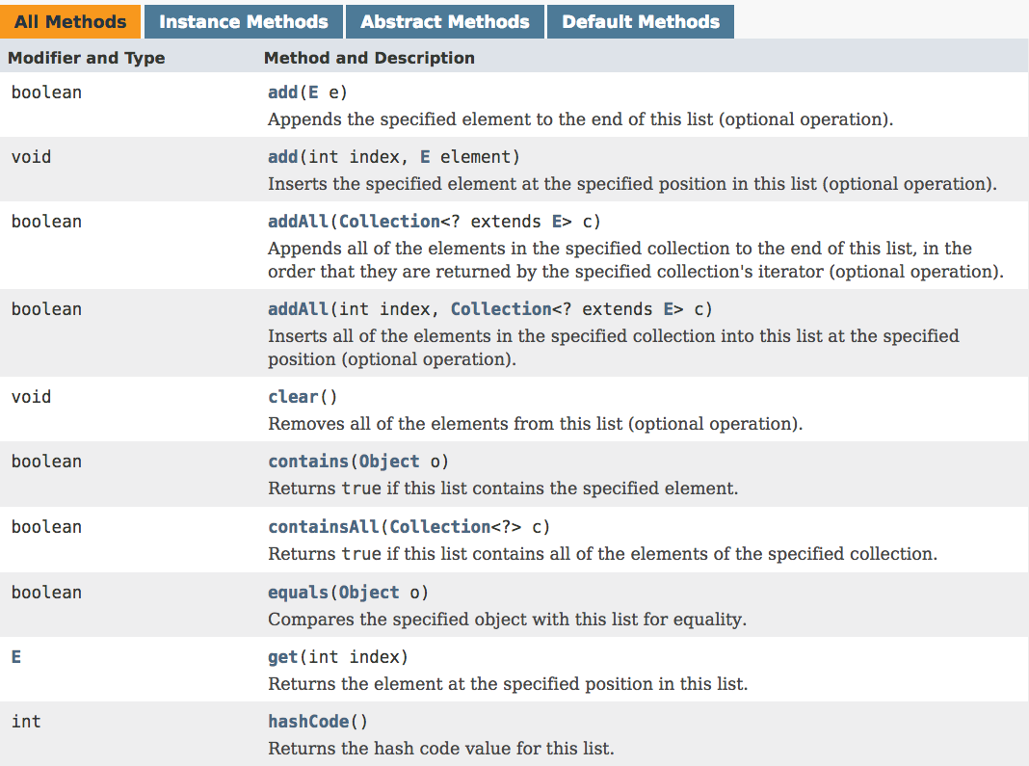
Using interfaces to standardize systems: Example 2
Observation: Many classes like LinkedList, ArrayList, Queue, ... represent collections of elements. All these collection types feature element-oriented operations like add, remove, compare, ...
Java’s List<T> interface features 28 abstract methods for list-oriented operations
Best practice
When designing a class that represents a collection of elements, consider making the class implement the List interface;
Classes that implement commonly-used interfaces are more readable, testable, familiar, and usable.
etc...

Slide 29
Lecture plan
Using interfaces for:
Type hierarchies
Polymorphism / heterogeneous collections
Standardizing software
Multiple inheritance

Slide 30


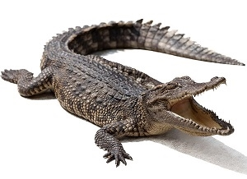
Multiple inheritance (in a nutshell)
public interface Animal {
/** Animal methods */
}
public interface Predator extends Animal {
/** Predator methods */
}
some animals are predators
some animals are amphibious
some are both predators and amphibious
public interface Amphibious extends Animal {
/** Amphibious methods */
}
public class Alligator implements Predator, Amphibious {
// Alligator fields and constructors declarations
/** Predator methods */ // mandatory
/** Amphibious methods */ // mandatory
/** Alligator methods */ // optional
}
An Alligator object has the behaviors of both a Predator and an Amphibious
A class can implement more than one interface
Results in a simple form of multiple inheritance.

Slide 31
Summary
Interfaces provide a relatively simple means for
Modeling type hierarchies
Polymorphic processing
Imposing order on software development projects
Multiple inheritance
And, unlike regular inheritance (sub-classing), interface-based inheritance is ...
Simple

Slide 32
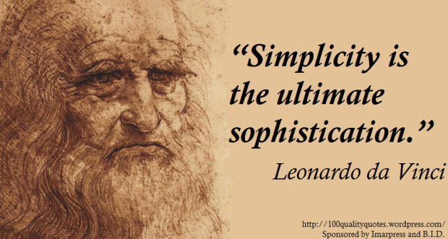
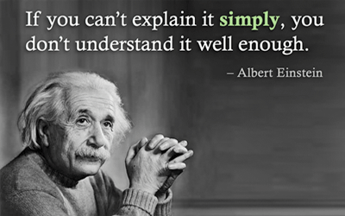
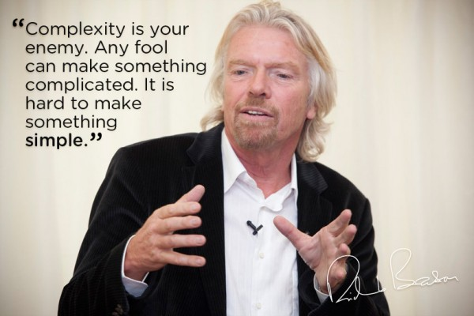
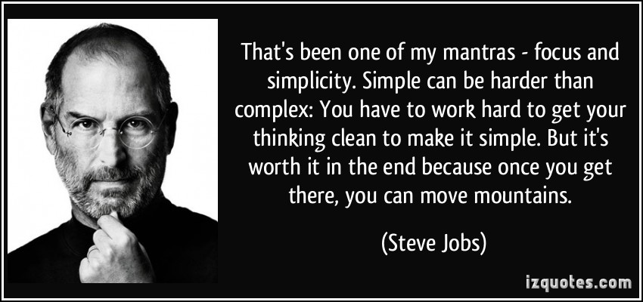
Simplicity
Simple

